Slide 1

A Single-Model Approach to the Winter Tail Risk
KUAS Team

Slide 2
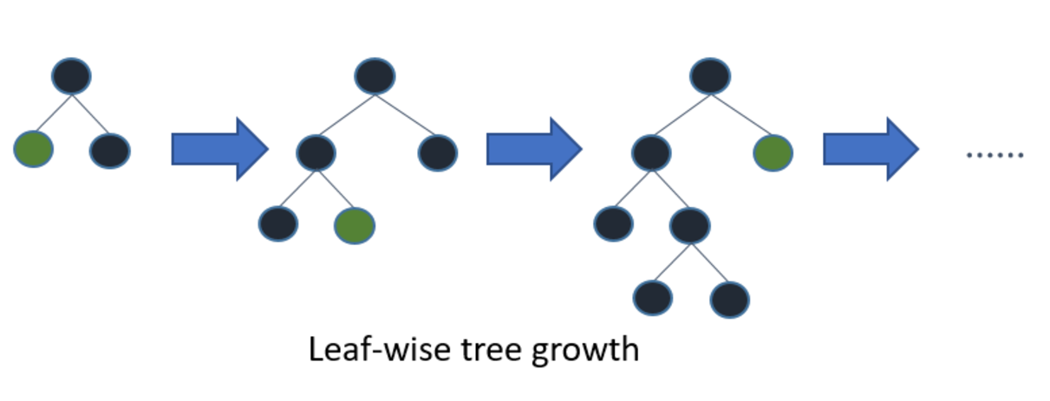




Model and Important Feature Transformation
Global LightGBM Model
One unified model across six markets
The Target Transformation
Important Predictive Features
$$y=arcsinh⁡(Price)$$
1. $Residual Demand=Load−(Solar+Wind)$
Safely compresses 5,000€ spikes
Prevents gradient explosion
Natively handles negative prices
2. $Tightness Ratio =\frac{Residual Demand}{Load+1}$
3. $Wind Power={\left(Wind Speed 80m\right)}^{3}$

Slide 3
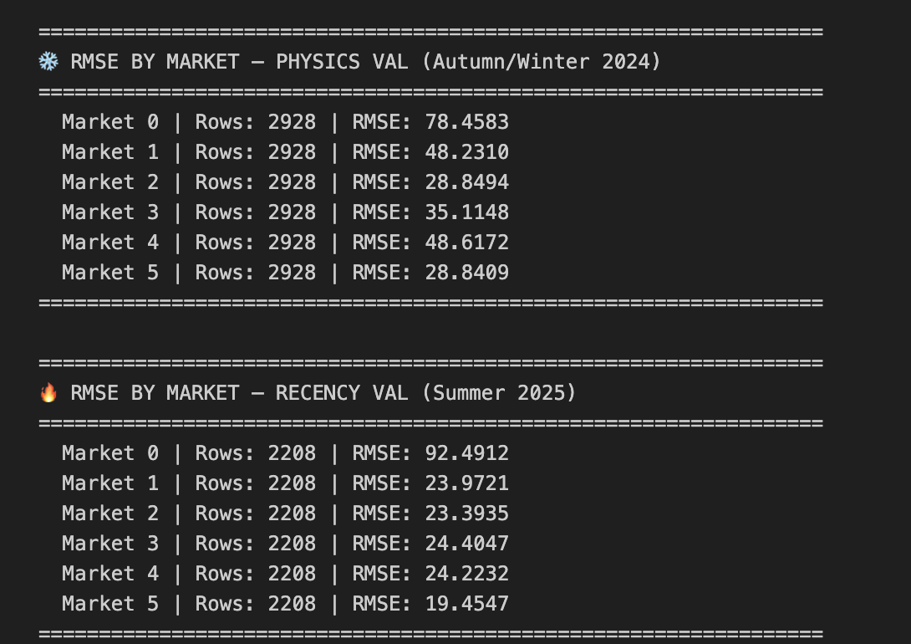
Validation Strategy and Asymmetric Weighting
Winter Data Validation
Validate exclusively on Autumn–Winter 2024 data
Ensures the model is evaluated on the most relevant conditions.
Asymmetric Weighting
Applied a 3.0x loss penalty to Autumn/Winter data during the training phase
Forcing the model to prioritize extreme winter spikes

Slide 4
Key Takeaways:
1
Physics Beat Ensembles
Incorporation of exact physical formulas like Wind ∝ v³ directly models real-world phenomena
Strict economic constraints based on Residual Demand provide a robust framework
Our single model outperformed blind machine learning ensembles
2
Validation Must Match Reality
Aligning the validation months strictly with the test set forced the model to focus entirely on its actual goal

